Slide 1
Sirius PCIe Review
Jiajie Zhang

Slide 2
CONTENT
PCIe Protocol
License IP
Arch
Integration
Simulation
Backend
Limitation
Ate Test
Bring Up
Reference

Slide 3
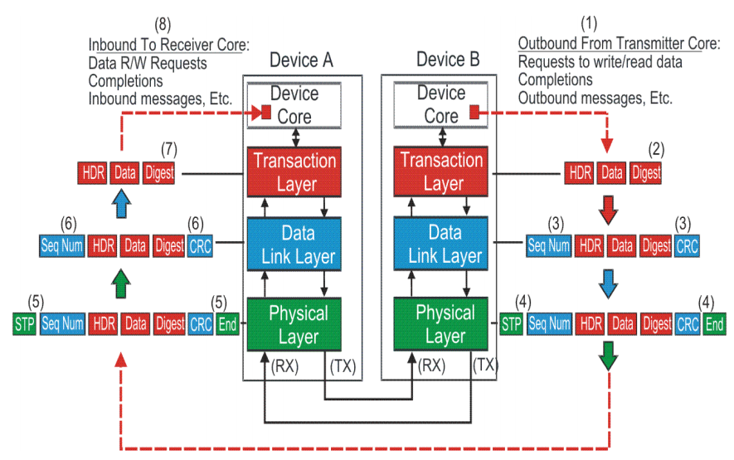
PCIe Protocol
PCI Express Layer

Slide 4
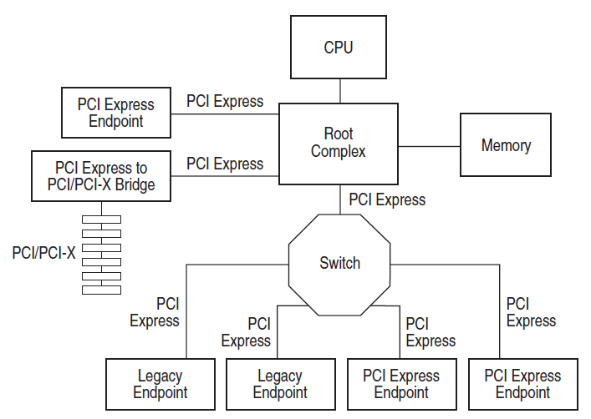
PCIe Protocol
Root Complex / Switch / Endpoint

Slide 5
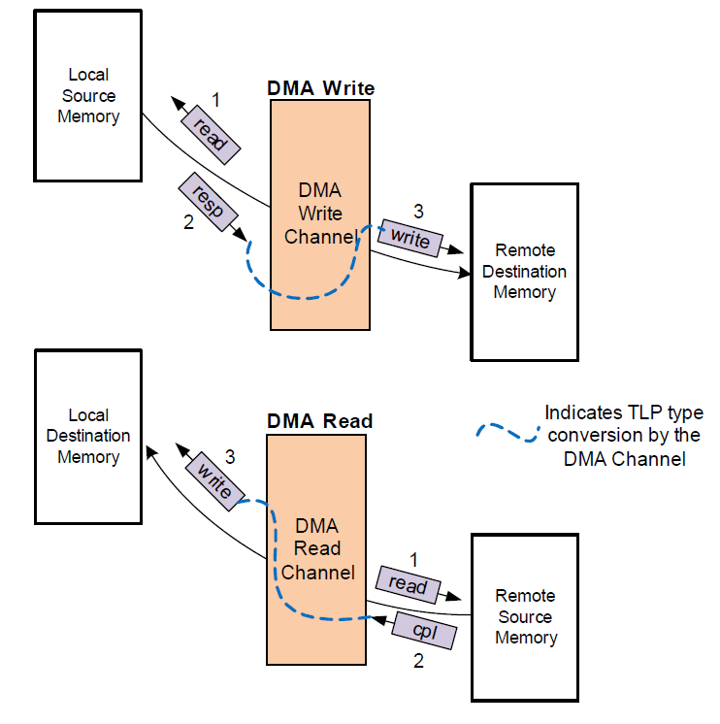
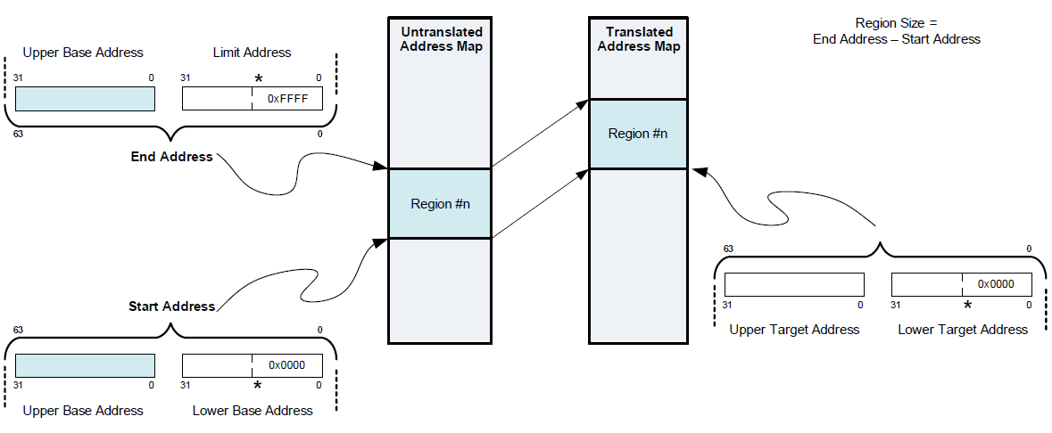
License IP: Synopsys PCIe dual mode (DM) controller
Features
All non-optional features of the PCI Express 2.0
Root complex / Endpoint
x2 Gen1, Gen2 lanes
32-bit Internal Datapath Operating at 125 or 250 MHz
AXI4 bridge
Internal Address Translation Unit
Two Embedded DMA

Slide 6
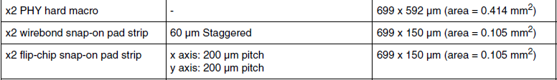
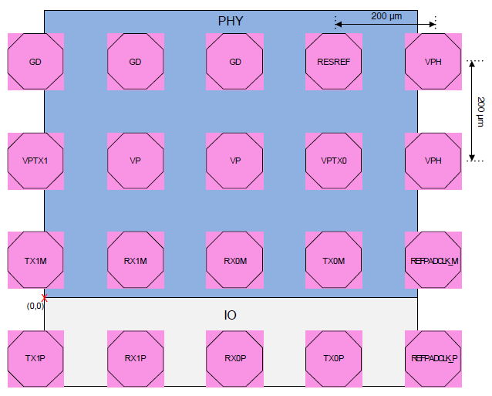
License IP: Synopsys PCIe 2 PHY
Features
Implement complete PCI Express 2.0 physical layer capability for 5-Gbps operation.
PIPE3-compliant transceiver interface, mapped onto 2 lanes.

Slide 7
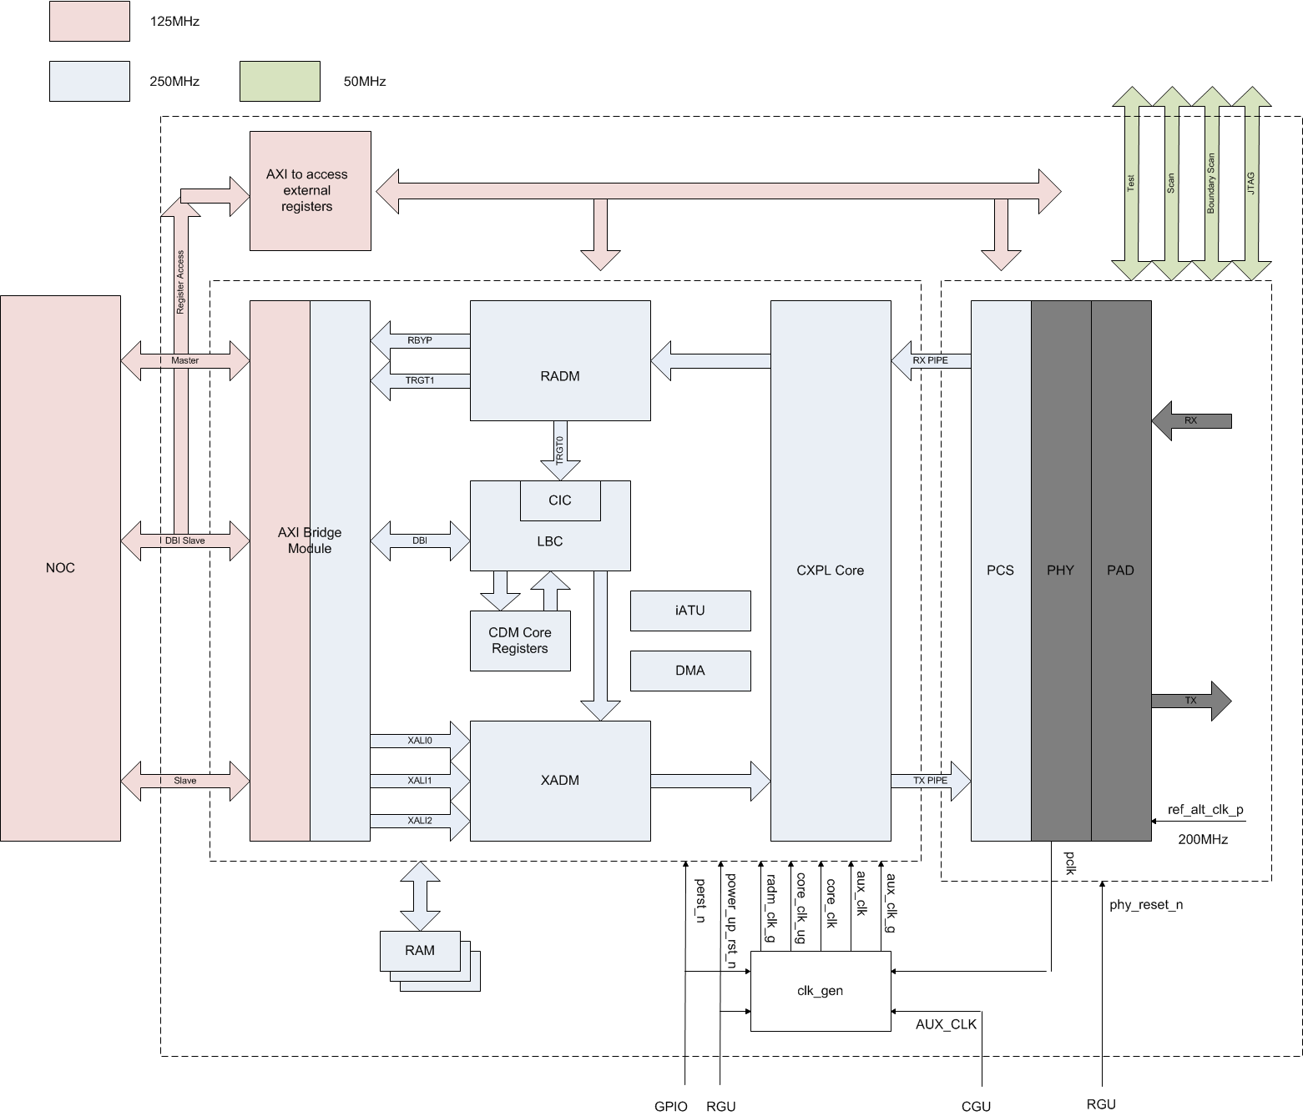
Architecture

Slide 8
Integrator Logic
Connect controller and phy through standard PIPE interface
Implement PCIe external registers
External memory replace
Hand-Placed logic

Slide 9
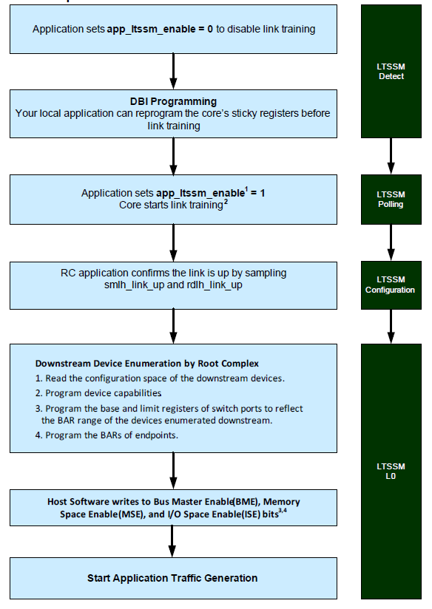
Initialization steps
Immediately upon powerup the DM controller goes into either EP mode or RC mode, depending on the state of the device_type register.

Slide 10
SIMULATION
LOCAL SIM
SOC SIM
EMU SIM

Slide 11
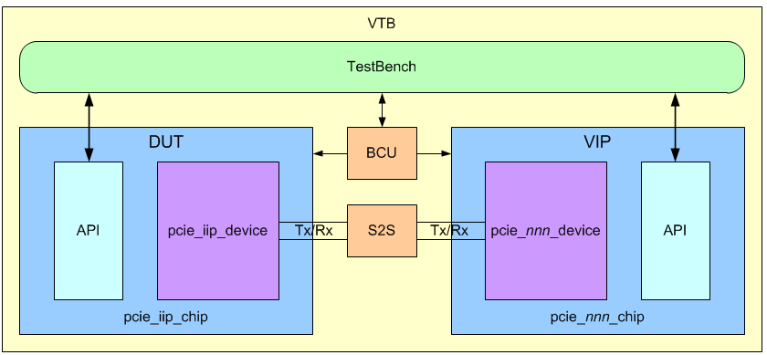
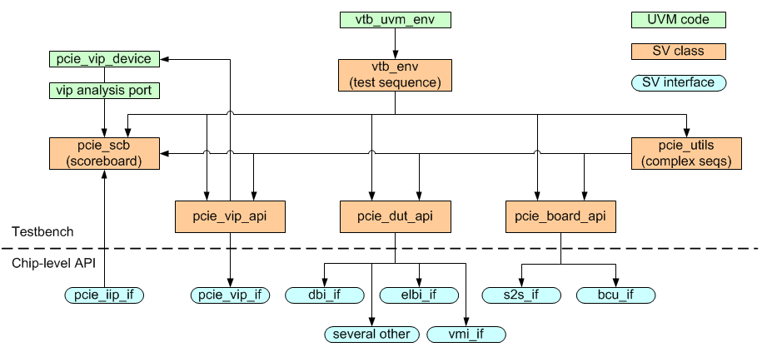
SIMULATION: Local Sim
Controller: DWC PCIe IIP - VTB

Slide 12
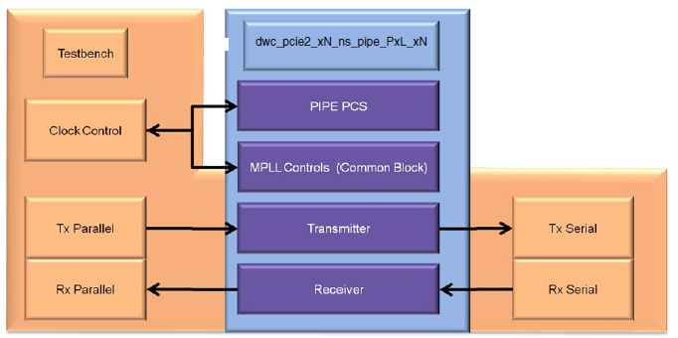
SIMULATION: Local Sim
PHY
Hard macro behavior / gate-level model
Receiver detection
Ate test pattern

Slide 13
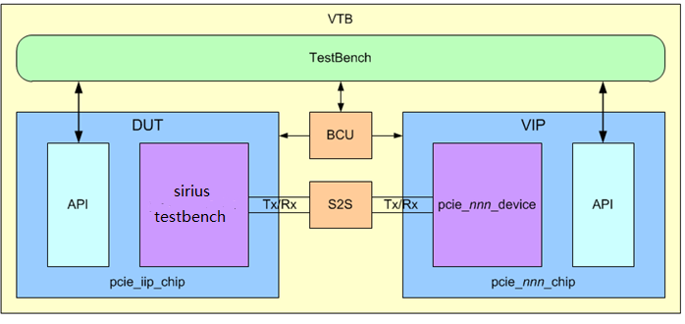
SIMULATION: SOC Sim
VTB reuse
Replace pcie_iip_device with sirius testbench
Interface to testbench.u_sirius_top.sirius_sub_3_inst.pcie_iip_device_inst
Replace tb sequence with firmware

Slide 14
SIMULATION: SOC Sim
Connect two sirius testbench using pcie link
Easy to replace rtl to netlist and run post sim

Slide 15
SIMULATION: EMU Sim
PCIe controller connect to Veloce model by PIPE3 interface
RC database / EP database

Slide 16
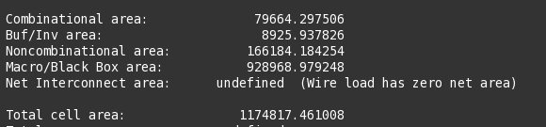
BACKEND: SYN
Integrate constraint of Controller & PHY
Macro/Black Box area: PHY + PAD + MEM =0.61 + 0.14 + 0.17 =0.92

Slide 17
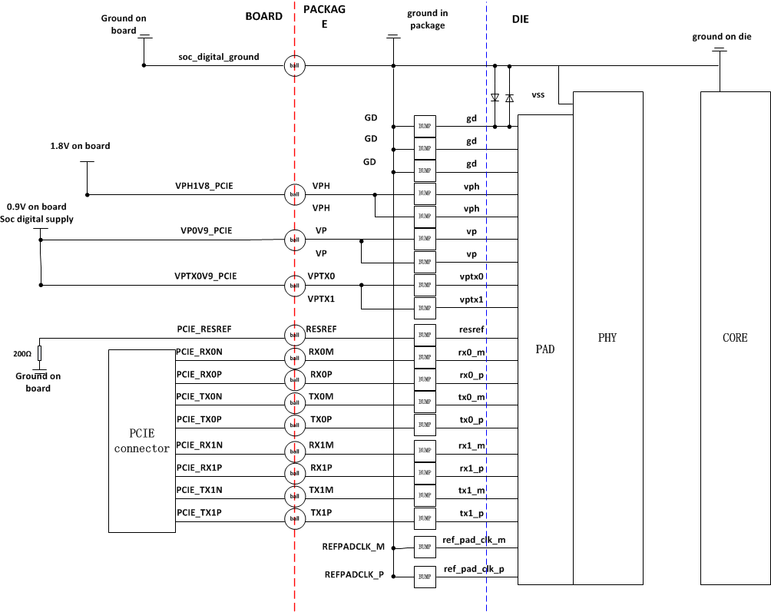
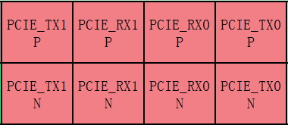
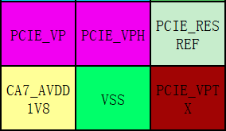
BACKEND: BUMP&&BALL
The length match between diff pairs are guaranteed by substrate and PCB design

Slide 18
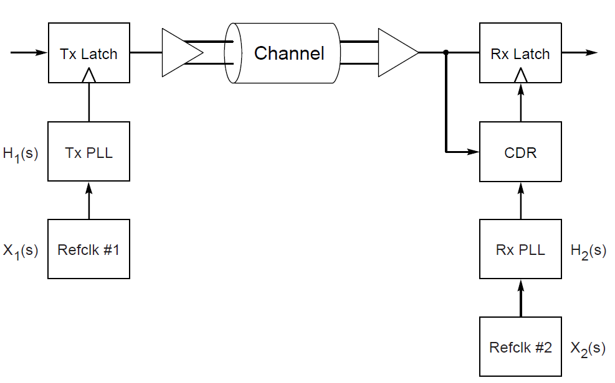
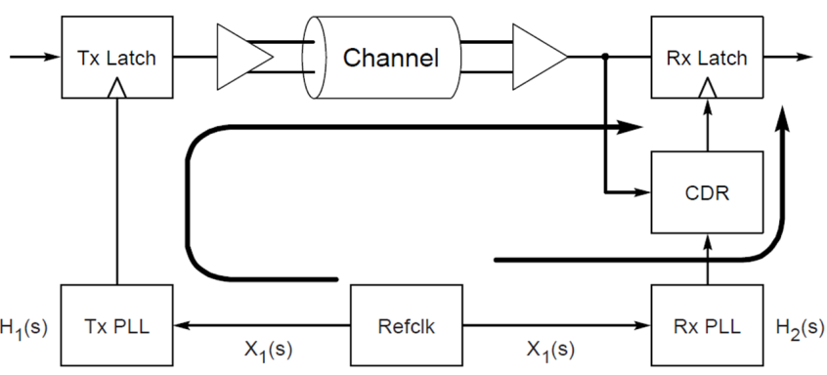
Limitation
LINK_CONTROL_LINK_STATUS_REG - PCIE_CAP_COMMON_CLK_CONFIG bit
Separate Refclk Architecture
using an on-chip clock source, tie the off-chip source to ground
Common Refclk Architecture
RC: ref_alt_clk_p/m for PCIe PHY and output to EP
EP: ref_pad_clk_p/m
Common Refclk Architecture (ssc support)
Separate Refclk Architecture

Slide 19
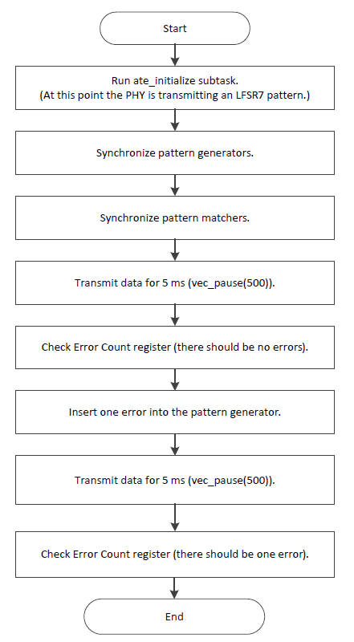
ATE_TEST
BERT test

Slide 20
Bring Up
PCIe | function validation | (RC/EP) Monitor out to PAD
 |  | (RC/EP) CLK frequency/RSTN check
 |  | (RC/EP) register default value check and read/write
 |  | (RC/EP) Link up interrupt check
 |  | (RC/EP) device id and vendor id access
 |  | (RC/EP) msix transaction test
 |  | (RC/EP) atu feature test
 |  | (RC/EP) atu bypass feature test
 |  | (RC/EP) dma ll feature test
 |  | (RC/EP) dma non ll feature test
 |  | (RC/EP) physical layer reset test
 |  | (RC/EP) link speeds test
 |  | (RC/EP) hot reset test
 |  | (RC/EP) link disable state test
 |  | (RC/EP) DDR access through remote pcie
 |  | (RC/EP) DMAC access axi slv
 |  | (RC/EP) Hot-Plug behavior
 | performance validation | (RC/EP) TOP DMAC and PCIE edma
 | physical validation | Eye Diagram
Monitor out logic
Link up interrupt
Feature test
Performance test

Slide 21
Reference
About spec
${git_server}/pub_doc/standard/pcie
About doc
${git_server}/sirius_doc/IP/PCIE

